Slide 1
Data Quest – Unlocking the Power of Data
(Case Study Challenge '23)
Track | From fork to fitness: Relationship between Eating Patterns and Obesity
College/University | PONDICHERRY UNIVERSITY (CENTRAL), PUDUCHERRY, 605014
Software Used | PYTHON, EXCEL
Student Name | Email ID | PG Course | Current semester
Sankhadeep Kundu | sankhadeepriju@gmail.com | 1st year MSc Statistics | 2
Shreya Wahi | wahishreya@gmail.com | 1st year MSc Statistics | 2
Dega Balaji Vara Prasad | dbalajivaraprasad@gmail.com | 1st year MSc Statistics | 2
Instructions:
(a) The below slides are mandatory. Addition of slides are allowed. The final PPT should not exceed more than 8 slides.
Use bullet pointers/graphs to make your presentation more concise and effective.

Slide 2
What is our data speaking?
Our data talks about two Treatments( A and B) that are used for the treatment of obesity in Teens from ages 14 -18. We have data on BMI, Weight, different demographic factors, and TestQ scores across 4 different visits from 250 patients. Of these 250, 125 are in Treatment A and the rest in Treatment B.
The data under study is not normal (by Shapiro-Wilk test), hence most of the analysis is done using appropriate non-parametric tests.
Since BMI is derived quantity from weight, we have considered BMI for the analyses and visualizations.
Results are reported based on Race, as each race in the data belongs to a particular country.
Discrepancy! Yes, with respect to gender, there are two observations where the gender at visit 0 and visit 1 are not matching with visits 2 and 3. Upon applying filter based on Age and Race, the mismatched observations were noticed and assigned them to its respective gender category.

Slide 3
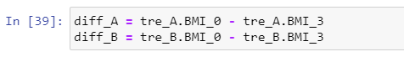

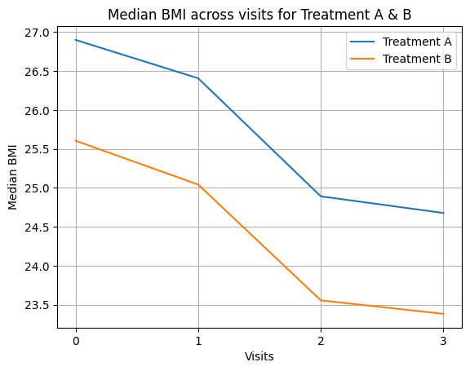
Do treatments A and B differ w.r.t BMI?
To see which treatment has benefited in reducing BMI over time, the data pertaining to visit3 & visit0 are considered. The difference between the visits was computed & Mann-Whitney U test was used for those differences.
Ho : median_diff_BMI_A = median_diff_BMI_B
INTERPRETATION: The p-value is 0.99 indicating that there’s no significant impact of Treatments A & B on controlling the BMI. The median of the differences in BMI was quite closer w.r.t Treatments A & B. Even though the median_diff_BMI_A(2.1939) was slightly lower than median_diff_BMI_B(2.2269), the minute difference does not make practical sense to make the claim that treatment B is better than treatment A.
To depict the pattern of BMI over the study time a line plot was used. The graph shows a parallel scenario between the two treatments.
Code results for Mann Whitney U test.
diff_A is the difference of mean BMI for visit 0 and visit 3 for treatment A
diff_B is the difference of mean BMI for visit 0 and visit 3 for treatment B
Visualisation 1

Slide 4
To see which treatment is helping more number of patients to reach a good BMI.
Here, our aim is to check that at the end of the treatment process, for which treatment, more number of patients have achieved a good BMI.
For this we apply the ‘2 sample z test for proportionality’, where keeping the healthy cut-off for BMI as 24.9[https://www.cdc.gov/obesity/basics/adult-defining.html], we classify the patients and calculate the proportion of healthy patients after the 3rd visit for both treatments.
INTERPRETATION: We observe that treatment B is giving better results for bringing the BMI of patients to the normal range. However, it is also observed that the patients subject to treatment B are already nearer to the normal BMI range than the patients under treatment A (i.e. patients under treatment 1 are more Obese than the ones under treatment B.)
This has however influenced the results. And hence we can conclude from our previous test, that there is no significant difference between the results of the two treatments.
Table 1
for treatment A at 3rd visit
no. of obese patients | 41
no. of healthy patients | 84
for treatment B at 3rd visit
no. of obese patients | 7
no. of healthy patients | 118
proportion of healthy patients
Treatment A | 0.672
Treatment B | 0.944
Two sided Z test Value | -5.4595
P value | 0.00

Slide 5
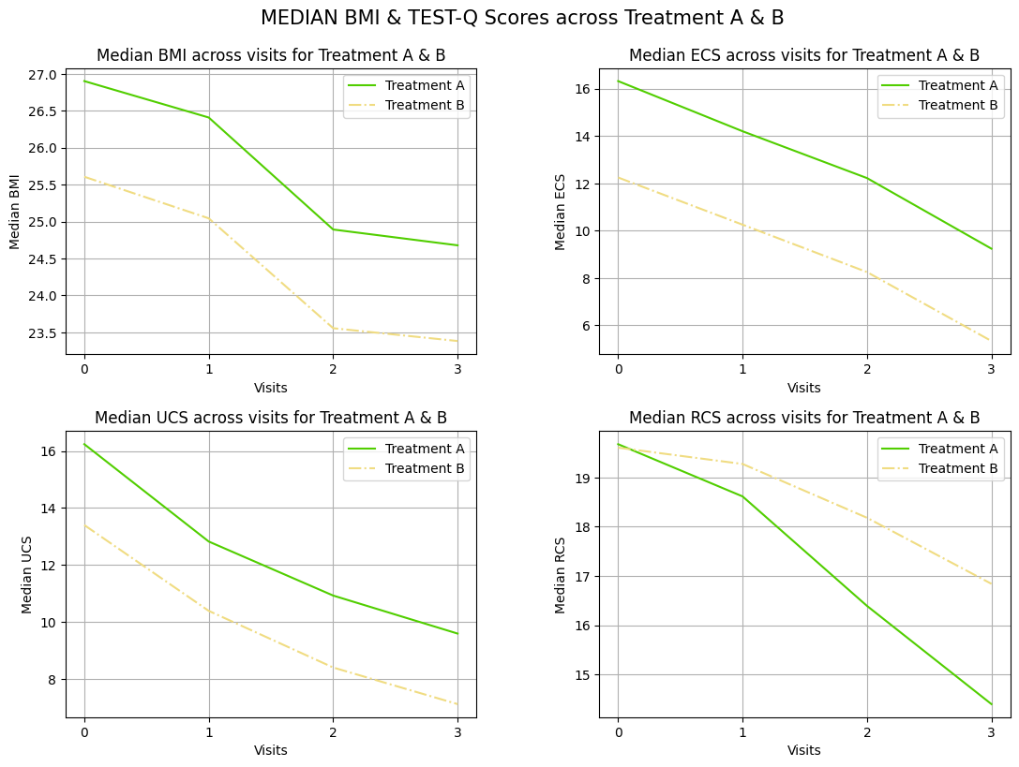
Observing the pattern of TestQs
To check the pattern of TestQs across the visits for treatments A and B, we have created profile plots for the Median ECS, RCS, and UCS scores.
We observe that in both the treatments, during the 0th and 1st visit, UCS decreased more than compared to other scores.
While the RCS score has decreased more and more after the 1st visit than the others.
INTERPRETATION: we can observe that after the treatments are given, the rate of depreciation in the scores is nearly equal for both treatments. However, out of all the scores, after visit 1, RCS drops very significantly for Treatment A.
Visualization 2

Slide 6
Further Scope and Recommendations :
(i) Testing the difference between the TestQ scores for treatments A and B
Table 2
Between Treatments
Score | Category | Median Treatment A | Median Treatment B | Normality | Test Statistic | Significance
ECS | Gender, Male | 7.3062 | 6.9742 | Fail | 0.01502 | Treatment A
UCS | Age, 15 | 6.8314 | 5.8789 | Pass | 0.009804 | Treatment A
 | Age, 17 | 6.7333 | 5.1855 | Fail | 0.04662 | Treatment A
ECS | Race, Caucasian | 6.3171 | 7.4336 | Pass | 0.014988 | Treatment B
RCS | Overall | 5.2741 | 2.7628 | Fail | 0.00000 | Treatment A
UCS | Overall | 6.6469 | 6.28838 | Pass | 0.037266 | Treatment A
Note: Mann whitney U test is conducted if normality is failed
INTERPRETATION: From the table above, we can observe the following results for the TestQ scores:
For ECS scores, Treatment A is better at lowering ECS scores than Treatment B for Males.
For ECS scores in Caucasian Race, Treatment B is better at lowering the scores than Treatment B.
For UCS scores in Ages 15 and 17, Treatment A is better at lowering the scores than Treatment B.
For overall UCS scores, Treatment A is better at lowering the scores than Treatment B.
For the overall RCS score, Treatment A is better at lowering the scores than Treatment B.

Slide 7
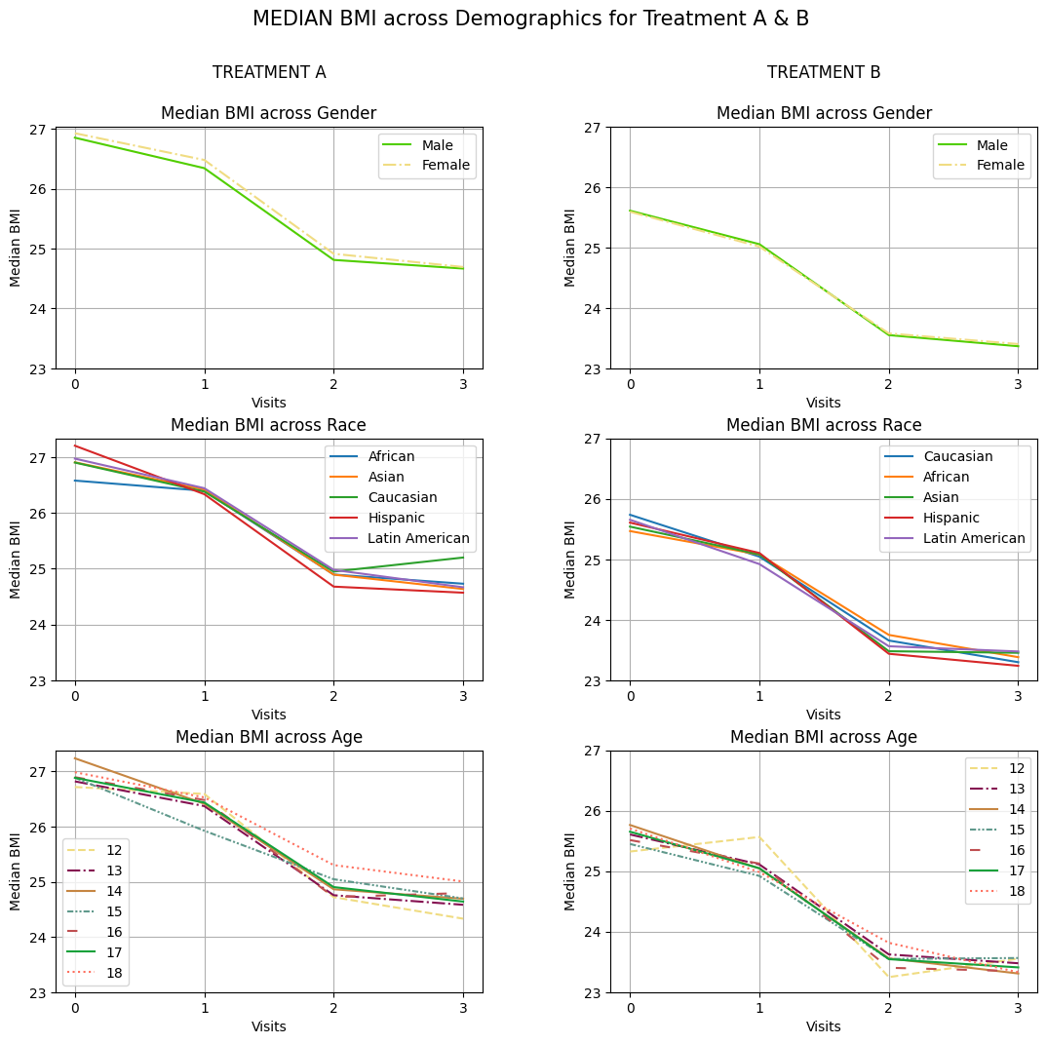
Visualization 3
(ii) Studying the Pattern of median BMI across Visits for different demographic factors for treatment A and B (Visualisation2)
Both Treatments work the same for both genders.
We observe a better decrease in the BMI of Hispanics under treatment A during the 1st visit. However, the BMI rises for Caucasians after the 2nd visit. Treatment B works the same for all races.
We see that patients of age 15 have a constant decrease in BMI throughout the study under treatment A, while the rate of decrease of BMI in patients of age 18 slows down after visit 1.
Under treatment B, patients of age 12 have been observed to have more BMI scores at visit 1 than at visit 0. However, the BMI has dropped after visit 1 till the end of the study.

Slide 8
CONCLUSION: We observe that Treatment A and Treatment B work the same and there is no significant difference between the two.
The value of TestQs decrease at the same rate(except RCS) for both treatments. This implies that the eating behavior gets healthier as the patients are treated. (RCS scores are controlled better with treatment A).
If there is a need to choose one treatment then Treatment B can be called our Magic Pill.
RECOMMENDATIONS:
Inadequate information on how the samples were recruited in to study.
Since, races across different regions are considered, the number of samples inducted in the study is too low and information on the population of these races is not clearly mentioned.

